Slide 1
Recurrence Relation
Notes:
‹#›

Slide 2
Recurrence Relation
A recurrence relation for the sequence, a₀, a₁,...a_{n}, is an equation that relates a_{n} to certain of its predecessors a₀, a₁, ... , a_{n-1}.
Initial conditions for the sequence a₀, a₁, ... are explicitly given values for a finite number of the terms of the sequence.

Slide 3
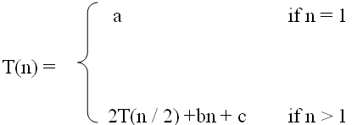
Definition
A recurrence relation, T(n), is a recursive function of integer variable n
Like all recursive functions, it has both recursive case and base case.
Example:
The portion of the definition that does not contain T is called the base case of the recurrence relation; the portion that contains T is called the recurrent or recursive case.
Recurrence relations are useful for expressing the running times (i.e., the number of basic operations executed) of recursive algorithms

Slide 4
Example: Fibonacci Sequence
The Fibonacci sequence is defined by recurrence relation
f_{n} = f_{n-1} + f_{n-2}, n>=3 and initial conditions
f₁ = 1, f₂ = 1.
Fibonacci Sequence: 1, 1, 2, 3, 5, 8, 13, 21,…….

Slide 5
Forming Recurrence Relation
For a given recursive method, the base case and the recursive case of its recurrence relation correspond directly to the base case and the recursive case of the method.
Example 1: Write the recurrence relation for the following method.
The base case is reached when n == 0. The method performs one comparison. Thus, the number of operations when n == 0, T(0), is some constant a.
When n > 0, the method performs two basic operations and then calls itself, using ONE recursive call, with a parameter n – 1.
Therefore the recurrence relation is:
void f(int n) { if (n > 0) {
cout<<n; f(n-1);
} }
T(0) = a
T(n) = b + T(n-1)
where a is constant
where b is constant, n>0
‹#›

Slide 6

Forming Recurrence Relation
Example 2: Write the recurrence relation for the following method.
The base case is reached when n == 1. The method performs one comparison and one return statement. Therefore, T(1), is constant c.
When n>1, the method performs TWO recursive calls, each with the parameter n/2, and some constant # of basic operations.
Hence, the recurrence relation is:
int g(int n) {
if (n == 1) return 2;
else
return 3 * g(n / 2) + g( n / 2) + 5;
}

Slide 7
Solving Recurrence Relation
To solve a recurrence relation T(n) we need to derive a form of T(n) that is not a recurrence relation. Such a form is called a “closed form” of the recurrence relation.
There are four methods to solve recurrence relations that represent the running time of recursive methods:
Iteration method (unrolling and summing)/Substitution method
Recursion Tree method
Master method

Slide 8
Solving Recurrence Relations - Iteration method
Steps:
Expand the recurrence
Express the expansion as a summation by plugging the recurrence back into itself until you see a pattern.
Evaluate the summation

Slide 9


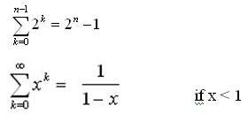

Solving Recurrence Relations - Iteration method
In evaluating the summation one or more of the following summation formulae may be used:
Arithmetic series:
Geometric Series: Special Cases of Geometric Series:

Slide 10

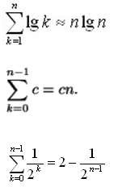
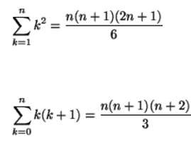
Solving Recurrence Relations - Iteration method
Harmonic Series
Others:

Slide 11
Analysis Of Recursive Factorial Method
Example 1: Form and solve the recurrence relation for the running time of factorial method and hence determine its
big-O complexity:
T(0) = c
T(n) = b + T(n - 1)
= b + b + T(n - 2)
= b +b +b + T(n - 3)
…
= kb + T(n - k)
When k = n, we have:
T(n) = nb + T(n - n)
= bn + T(0)
= bn + c.
Therefore method factorial is O(n).
long factorial (int n) {
if (n == 0) return 1;
else
return n * factorial (n – 1);
}

Slide 12
Analysis Of Recursive Binary Search
public int binarySearch (int target, int[] array,
int low, int high) {
if (low > high) return -1;
else {
int middle = (low + high)/2;
if (array[middle] == target)
return middle;
else if(array[middle] < target)
return binarySearch(target, array, middle + 1, high); else
return binarySearch(target, array, low, middle - 1);
}
}
The recurrence relation for the running time of the method is:
The recurrence relation for the running time of the method is:
T(1) = a
T(n) = T(n / 2) + b
if n = 1 (one element array) if n > 1

Slide 13
Analysis Of Recursive Binary Search
Expanding:
T(n) = T(n / 2) + b
= [T(n / 4) + b] + b = T (n / 2²) + 2b
= [T(n / 8) + b] + 2b = T(n / 2³) + 3b
= ……..
= T( n / 2^{k}) + kb
When n / 2^{k} = 1 🡺 n = 2^{k} 🡺 k = log₂ n, we have:
T(n) = T(1) + b log₂ n
= a + b log₂ n
Therefore, Recursive Binary Search is O(log n)

Slide 14
Solving Recurrence Relations-Substitution Method
The substitution method
A.k.a. the “making a good guess method”
Guess the form of the answer, then use induction to find the constants and show that solution works
Run an example: merge sort
T(n) = 2T(n/2) + cn
We guess that the answer is O(n lg n)
Prove it by induction
Can similarly show T(n) = Ω(n lg n), thus Θ(n lg n) 24

Slide 15
Solving Recurrence Relations-Substitution Method
Example: T(n) = 2T(n/2) + n
Guess T(n) ≤ cn log n for some constant c (that is, T(n) = O(n log n))
T(n) = 2T(n/2) + n ≤ 2(c n/2 log n/2 ) + n
= cn log n/2 + n
= cn log n − cn log 2 + n
= cn log n − cn + n
if c ≥ 1 , condition is satisfied.
Thus, T(n) = O(n log n)

Slide 16
Recursion-tree method
A recursion tree models the costs (time) of a recursive execution of an algorithm.
The recursion tree method is good for generating guesses for the substitution method.
The recursion-tree method can be unreliable.
The recursion-tree method promotes intuition, however.
In this case, only the largest term in the geometric series matters; all of the other terms are swallowed up by the Θ(·) notation.

Slide 17
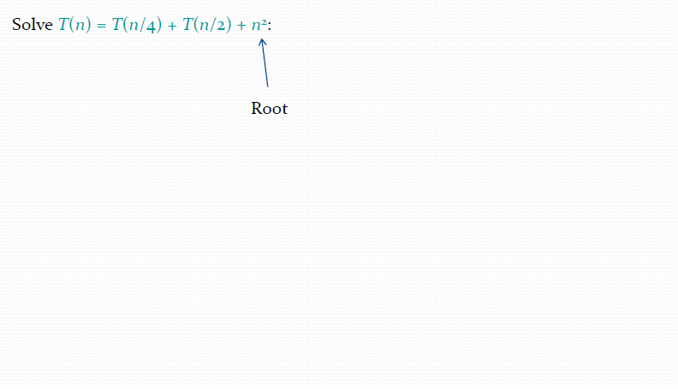
Example of recursion tree

Slide 18
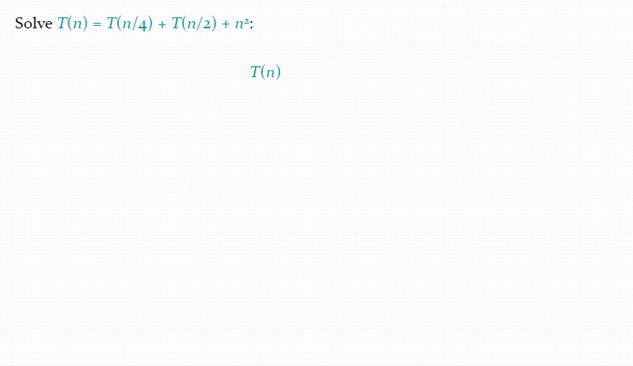
Example of recursion tree

Slide 19
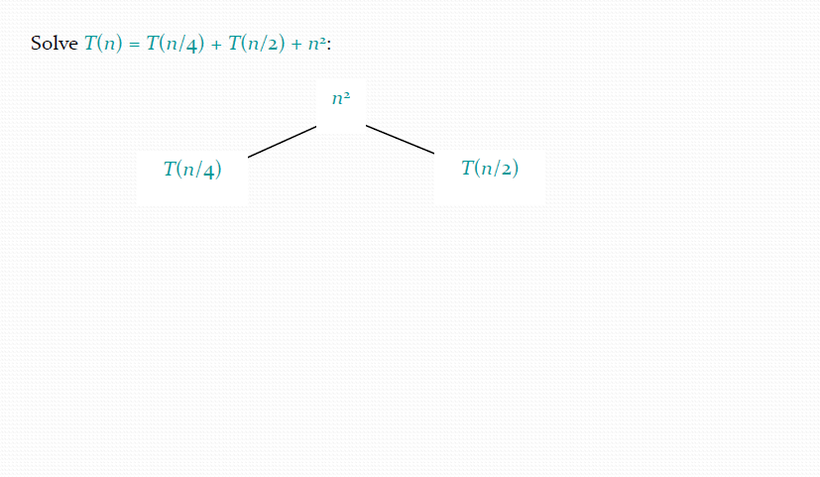
Example of recursion tree

Slide 20
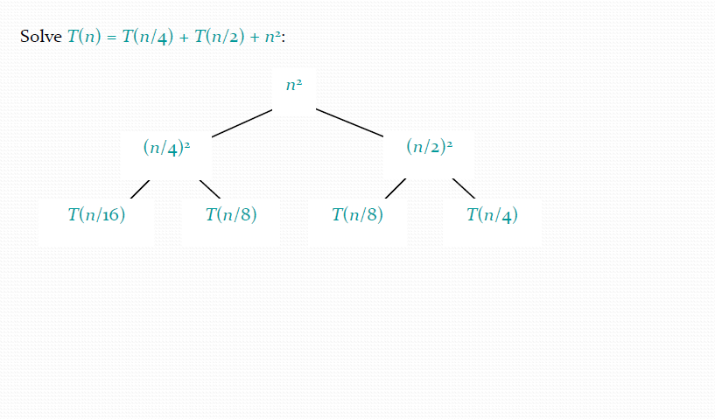
Example of recursion tree

Slide 21
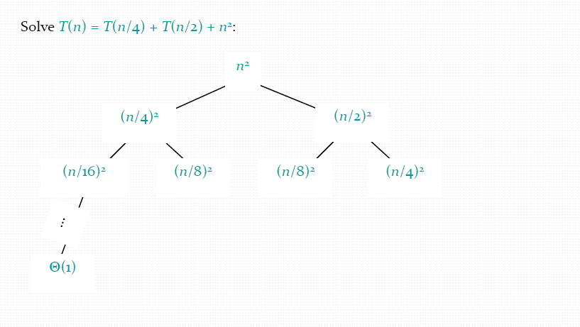
Example of recursion tree

Slide 22
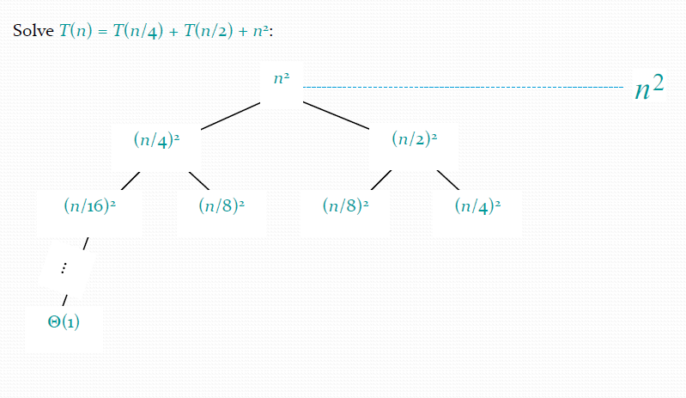
Example of recursion tree

Slide 23
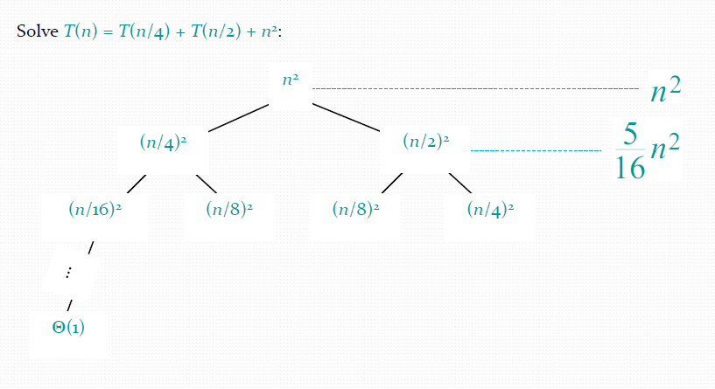
Example of recursion tree

Slide 24
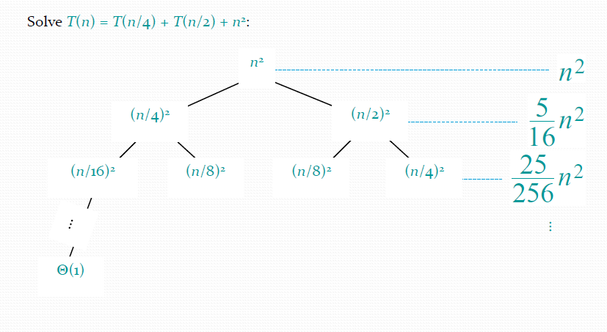
Example of recursion tree

Slide 25
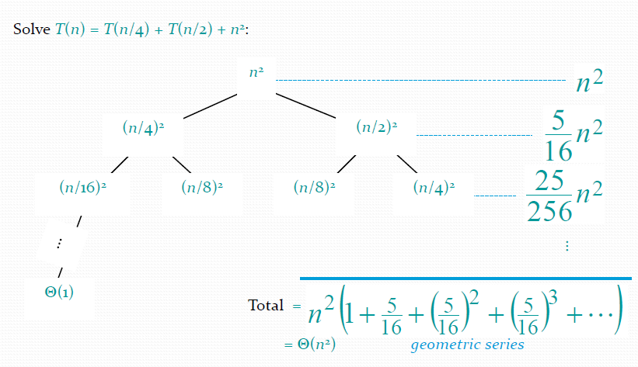
Example of recursion tree

Slide 26
Solving Recurrence Relations-
The Master Theorem
Given: a divide and conquer algorithm
An algorithm that divides the problem of size n into a subproblems, each of size n/b
Let the cost of each stage (i.e., the work to divide the problem + combine solved subproblems) be described by the function f(n).
Then, the Master Theorem gives us a method for the algorithm’s running time:

Slide 27
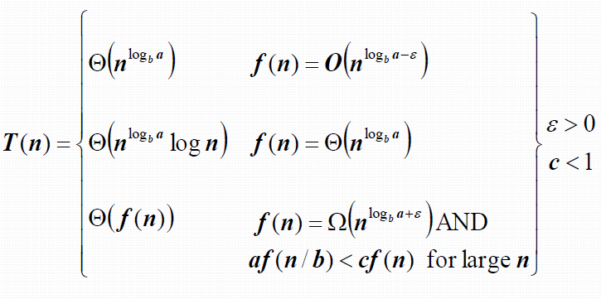
The Master Theorem
if T(n) = aT(n/b) + f(n) then (where a>=1, b>1)

Slide 28
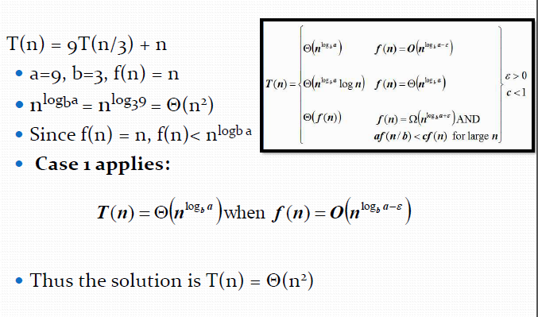
The Master Theorem

Slide 29
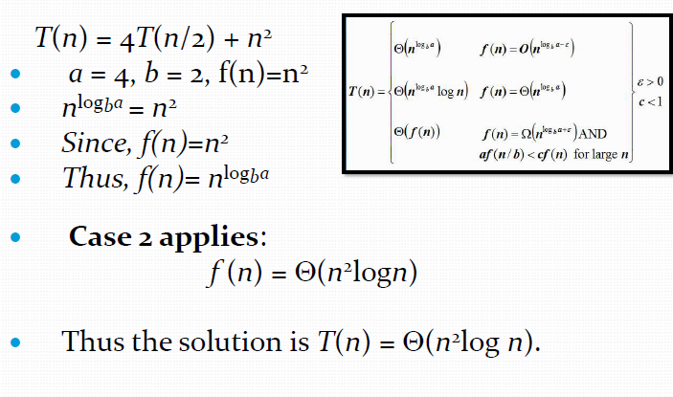
The Master Theorem

Slide 30
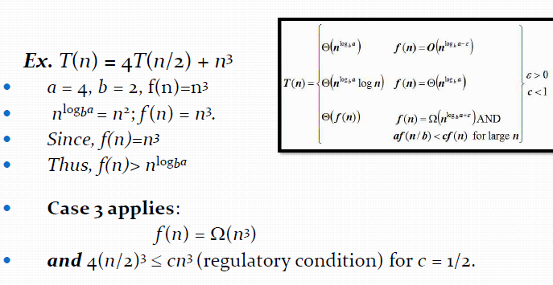
The Master Theorem

Slide 31
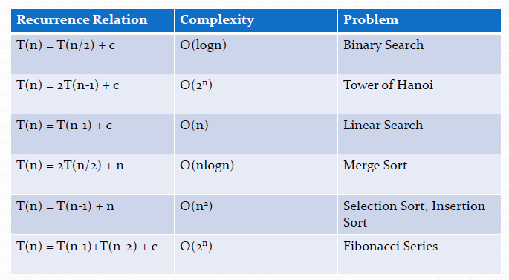
Some Common Recurrence Relation

Slide 32
Summary
Recurrence Relation
Iteration method (unrolling and summing)/Substitution method
Recursion Tree method
Master method

